Slide 1
PEDIATRIC NURSING
Newborn Reflexes (2024)
انعكاسات حديثي الولادة (Reflexes 2024)
Pediatric Nursing · Practical Lectures
Source document: Reflexes 2024.pdf
14 pages · Nursing Lectures · Level 26–27
Notes:
Title slide generated from Reflexes 2024.pdf (14 pages). Source text is reproduced verbatim in the notes of every content slide.

Slide 2
PEDIATRIC NURSING
Learning Objectives
• Defining the importance of reflexes assessment in children.
• Demonstrate how to assess reflexes in infants.
• Discuss the type of reflexes( sucking, rooting, Babinski, startle and Moro reflexes …etc.).
• Explain the child's response to each reflex according to the offered type .
Newborn Reflexes (2024)
1
Notes:
Learning objectives taken verbatim from page 2 of Reflexes 2024.pdf.

Slide 3
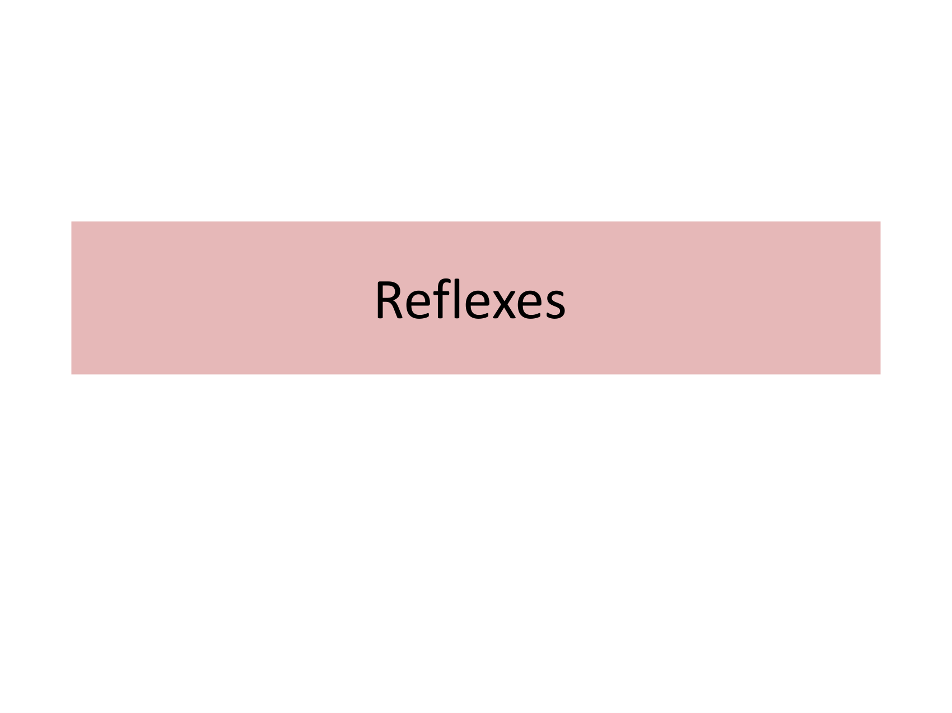
Reflexes · source page 1 of 14
Notes:
Reflexes
Dr. Mohammed T Aljubori

Slide 4
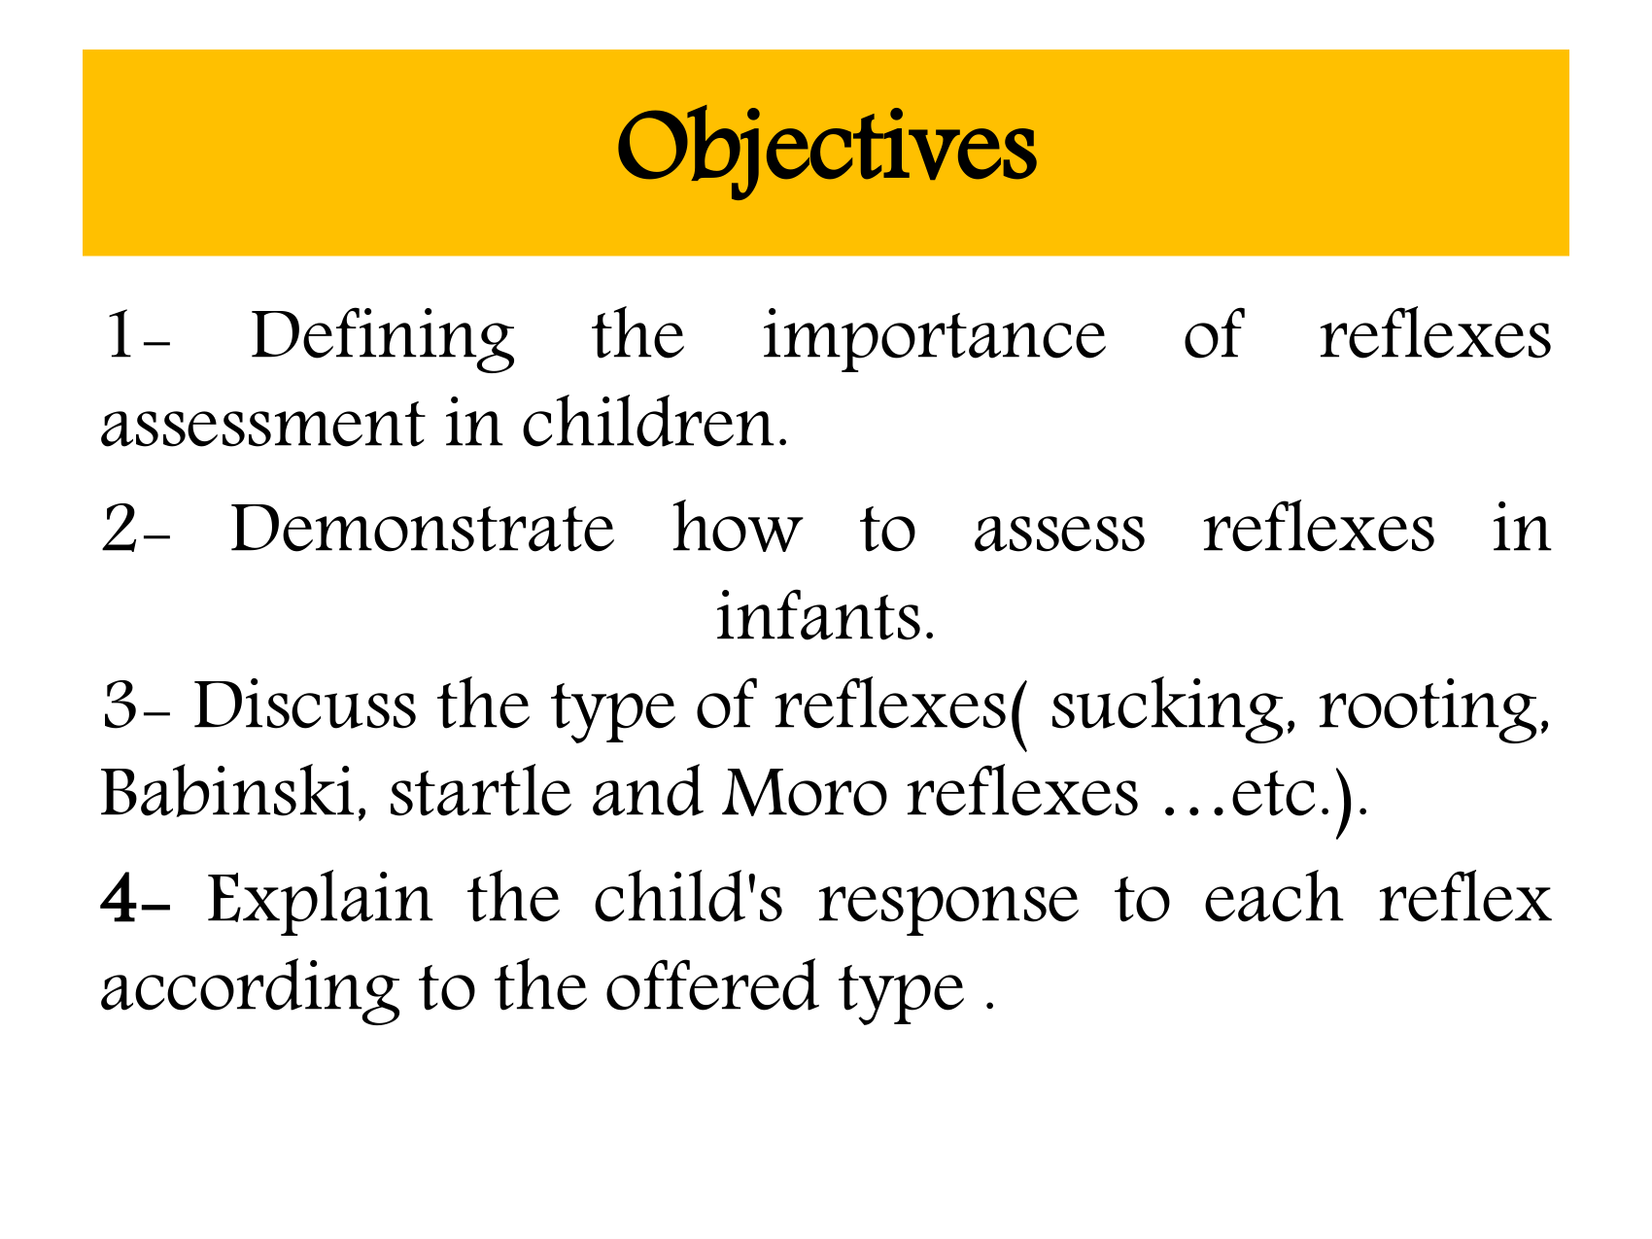
Objectives · source page 2 of 14
Notes:
Objectives
1-
Defining the importance of reflexes
assessment in children.
2- Demonstrate how to assess reflexes in
infants.
3- Discuss the type of reflexes( sucking, rooting,
Babinski, startle and Moro reflexes …etc.).
4- Explain the child's response to each reflex
according to the offered type .

Slide 5
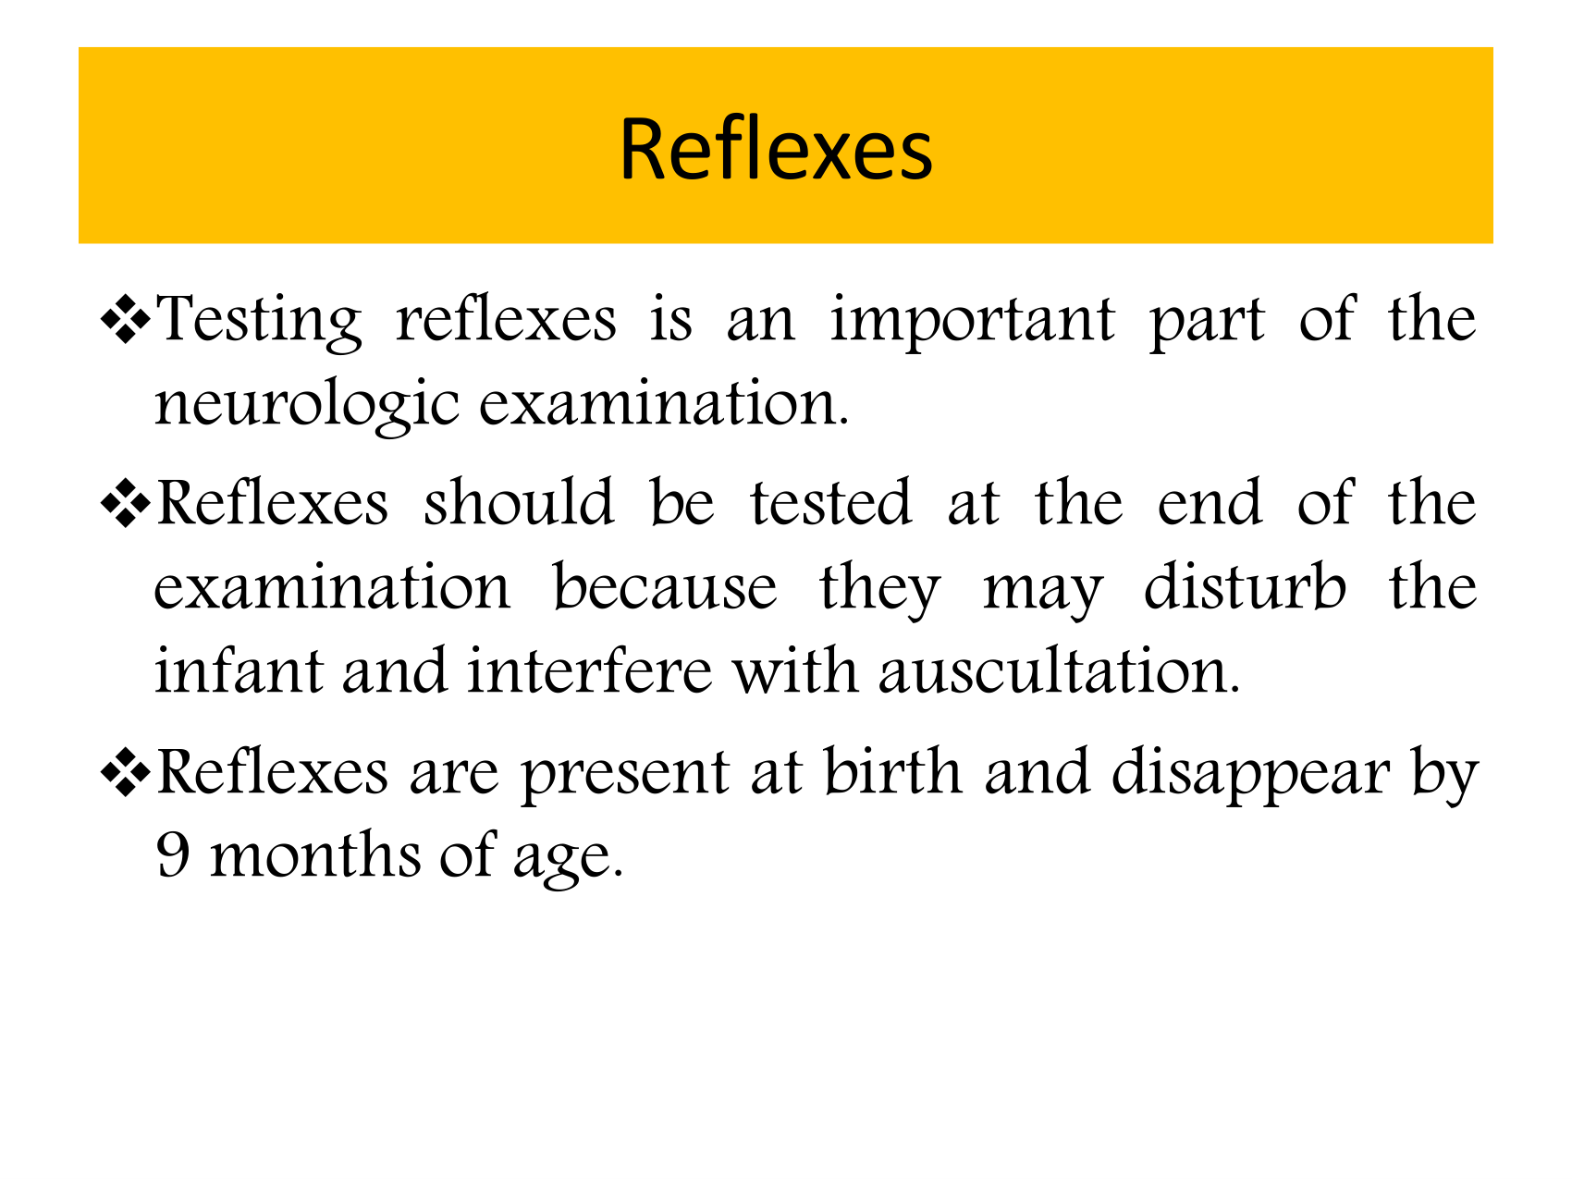
Reflexes · source page 3 of 14
Notes:
Reflexes
Testing reflexes is an important part of the
neurologic examination.
Reflexes should be tested at the end of the
examination because they may disturb the
infant and interfere with auscultation.
Reflexes are present at birth and disappear by
9 months of age.

Slide 6
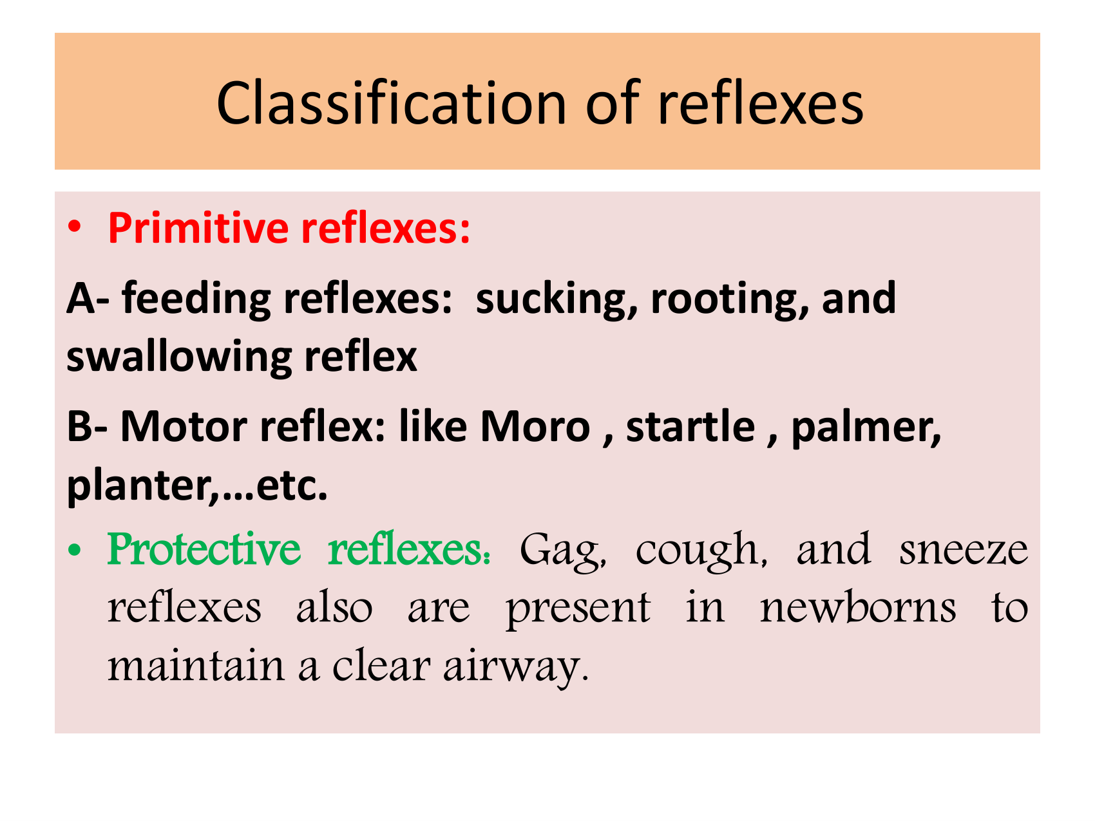
Classification of reflexes · source page 4 of 14
Notes:
Classification of reflexes
• Primitive reflexes:
A- feeding reflexes: sucking, rooting, and
swallowing reflex
B- Motor reflex: like Moro , startle , palmer,
planter,…etc.
• Protective reflexes: Gag, cough, and sneeze
reflexes also are present in newborns to
maintain a clear airway.

Slide 7
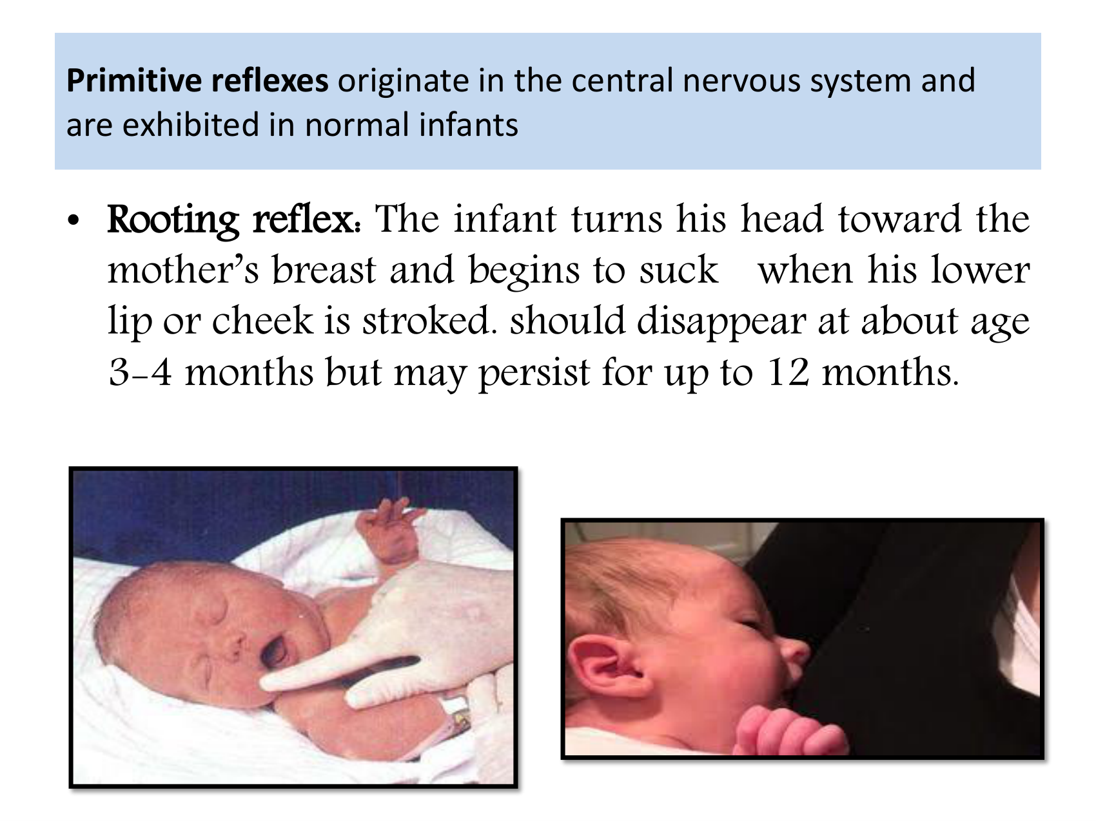
Primitive reflexes originate in the central nervous system and are exhibited in normal infants · source page 5 of 14
Notes:
Primitive reflexes originate in the central nervous system and
are exhibited in normal infants
• Rooting reflex: The infant turns his head toward the
mother’s breast and begins to suck when his lower
lip or cheek is stroked. should disappear at about age
3-4 months but may persist for up to 12 months.

Slide 8
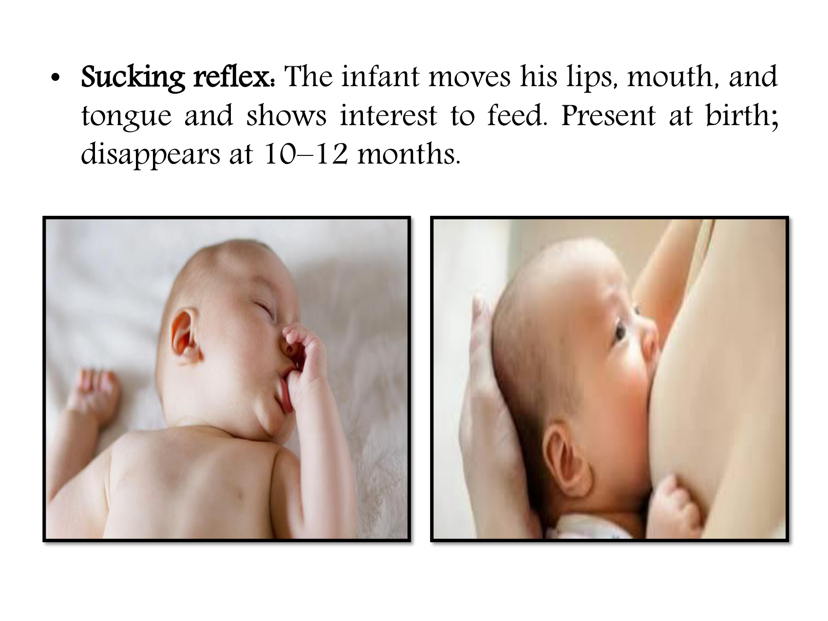
Newborn Reflexes (2024) · source page 6 of 14
Notes:
• Sucking reflex: The infant moves his lips, mouth, and
tongue and shows interest to feed. Present at birth;
disappears at 10–12 months.

Slide 9
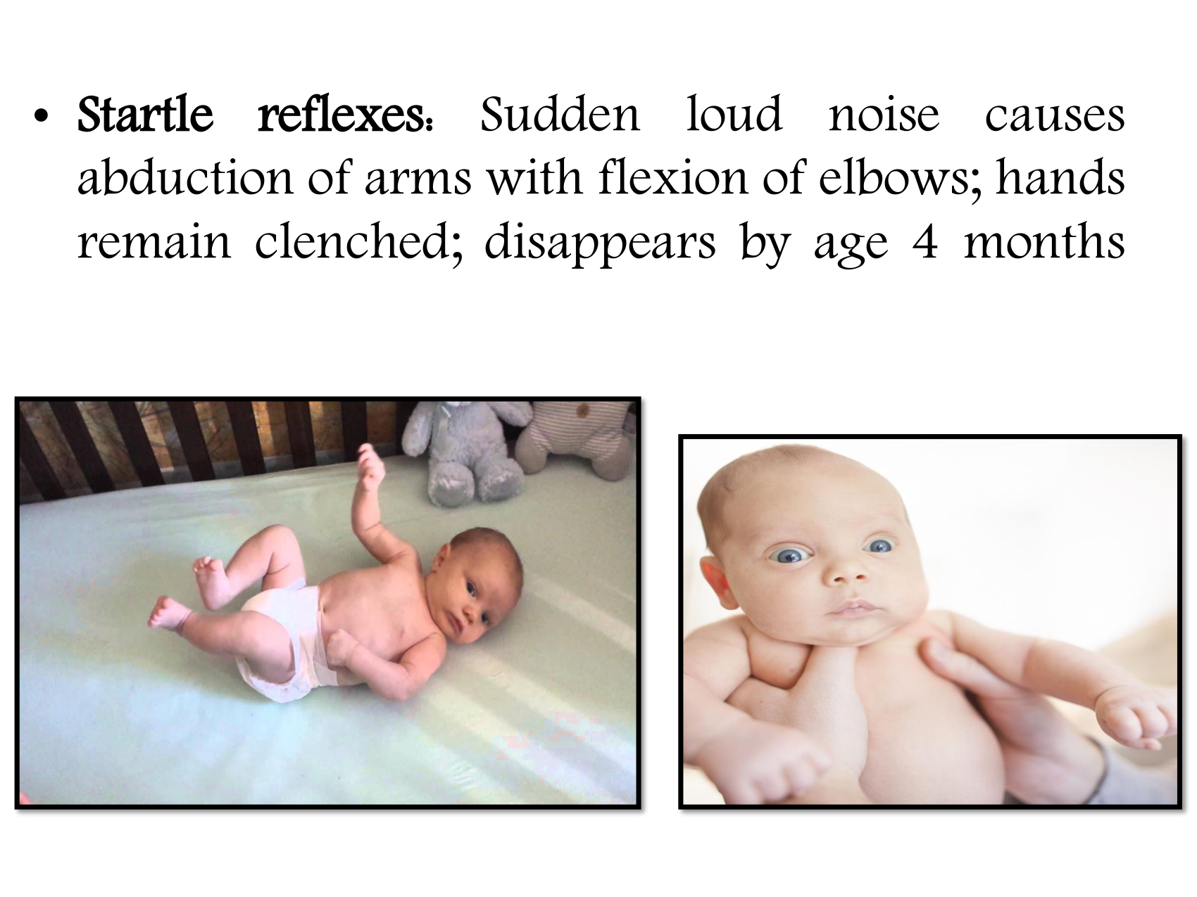
Newborn Reflexes (2024) · source page 7 of 14
Notes:
• Startle
reflexes:
Sudden
loud
noise
causes
abduction of arms with flexion of elbows; hands
remain clenched; disappears by age 4 months

Slide 10
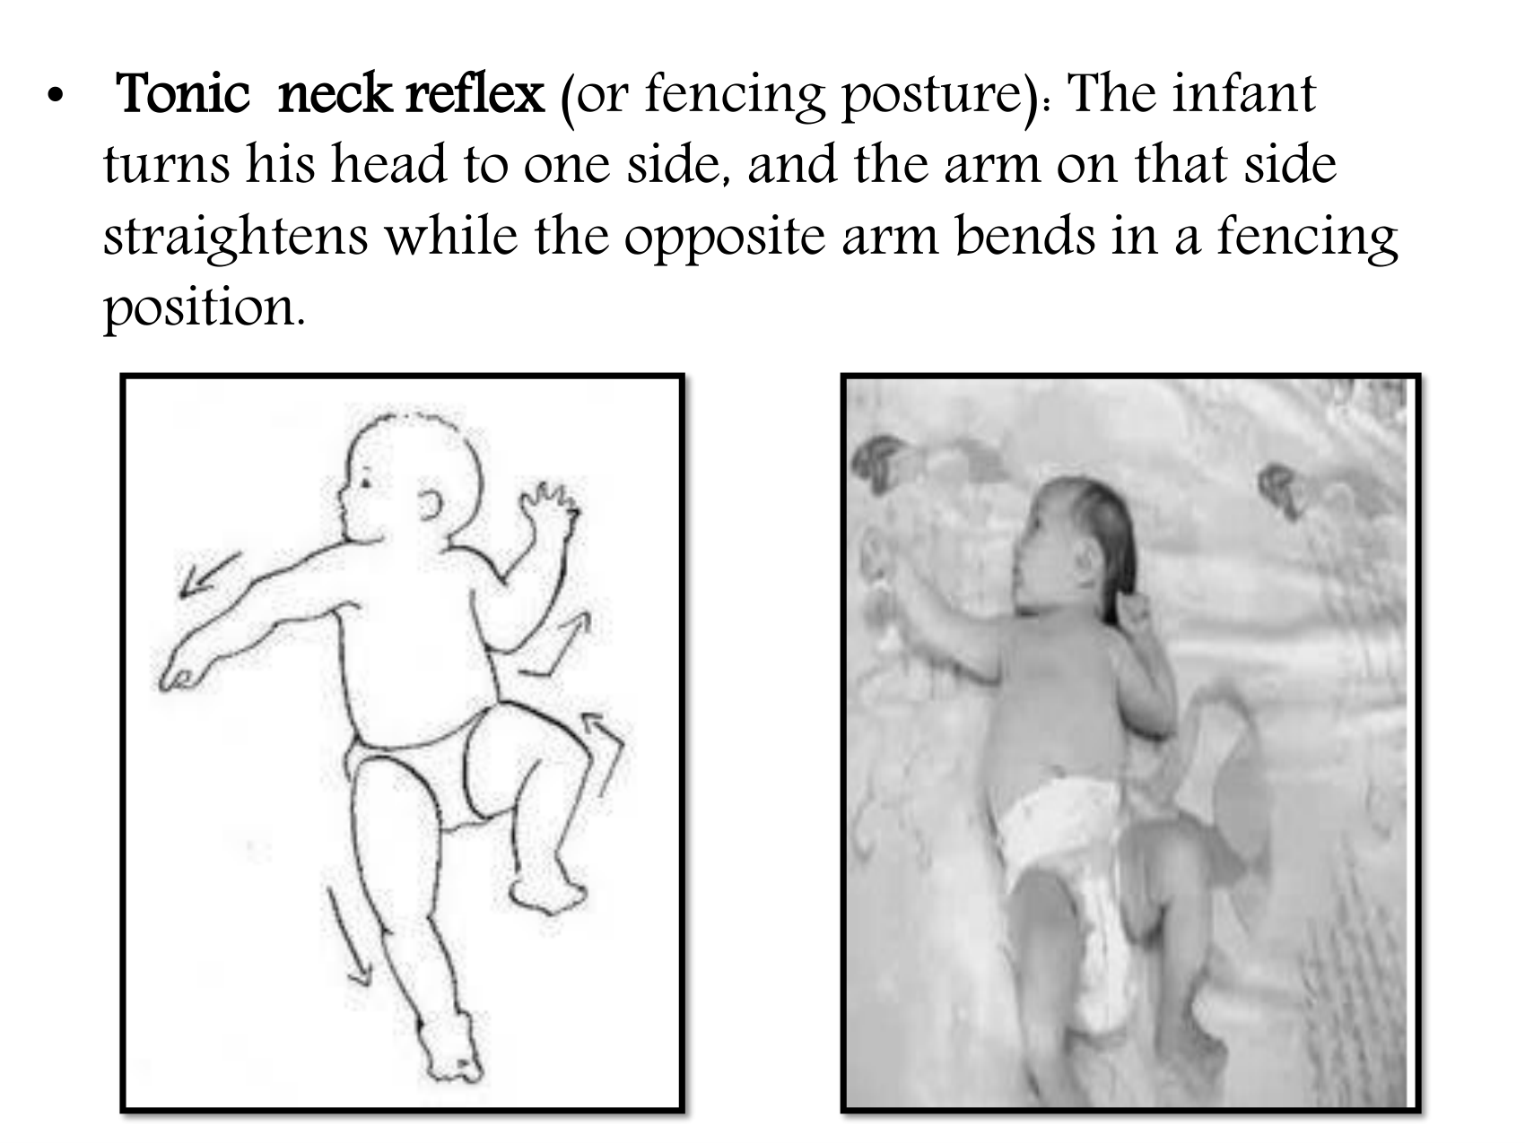
Newborn Reflexes (2024) · source page 8 of 14
Notes:
•
Tonic neck reflex (or fencing posture): The infant
turns his head to one side, and the arm on that side
straightens while the opposite arm bends in a fencing
position.

Slide 11
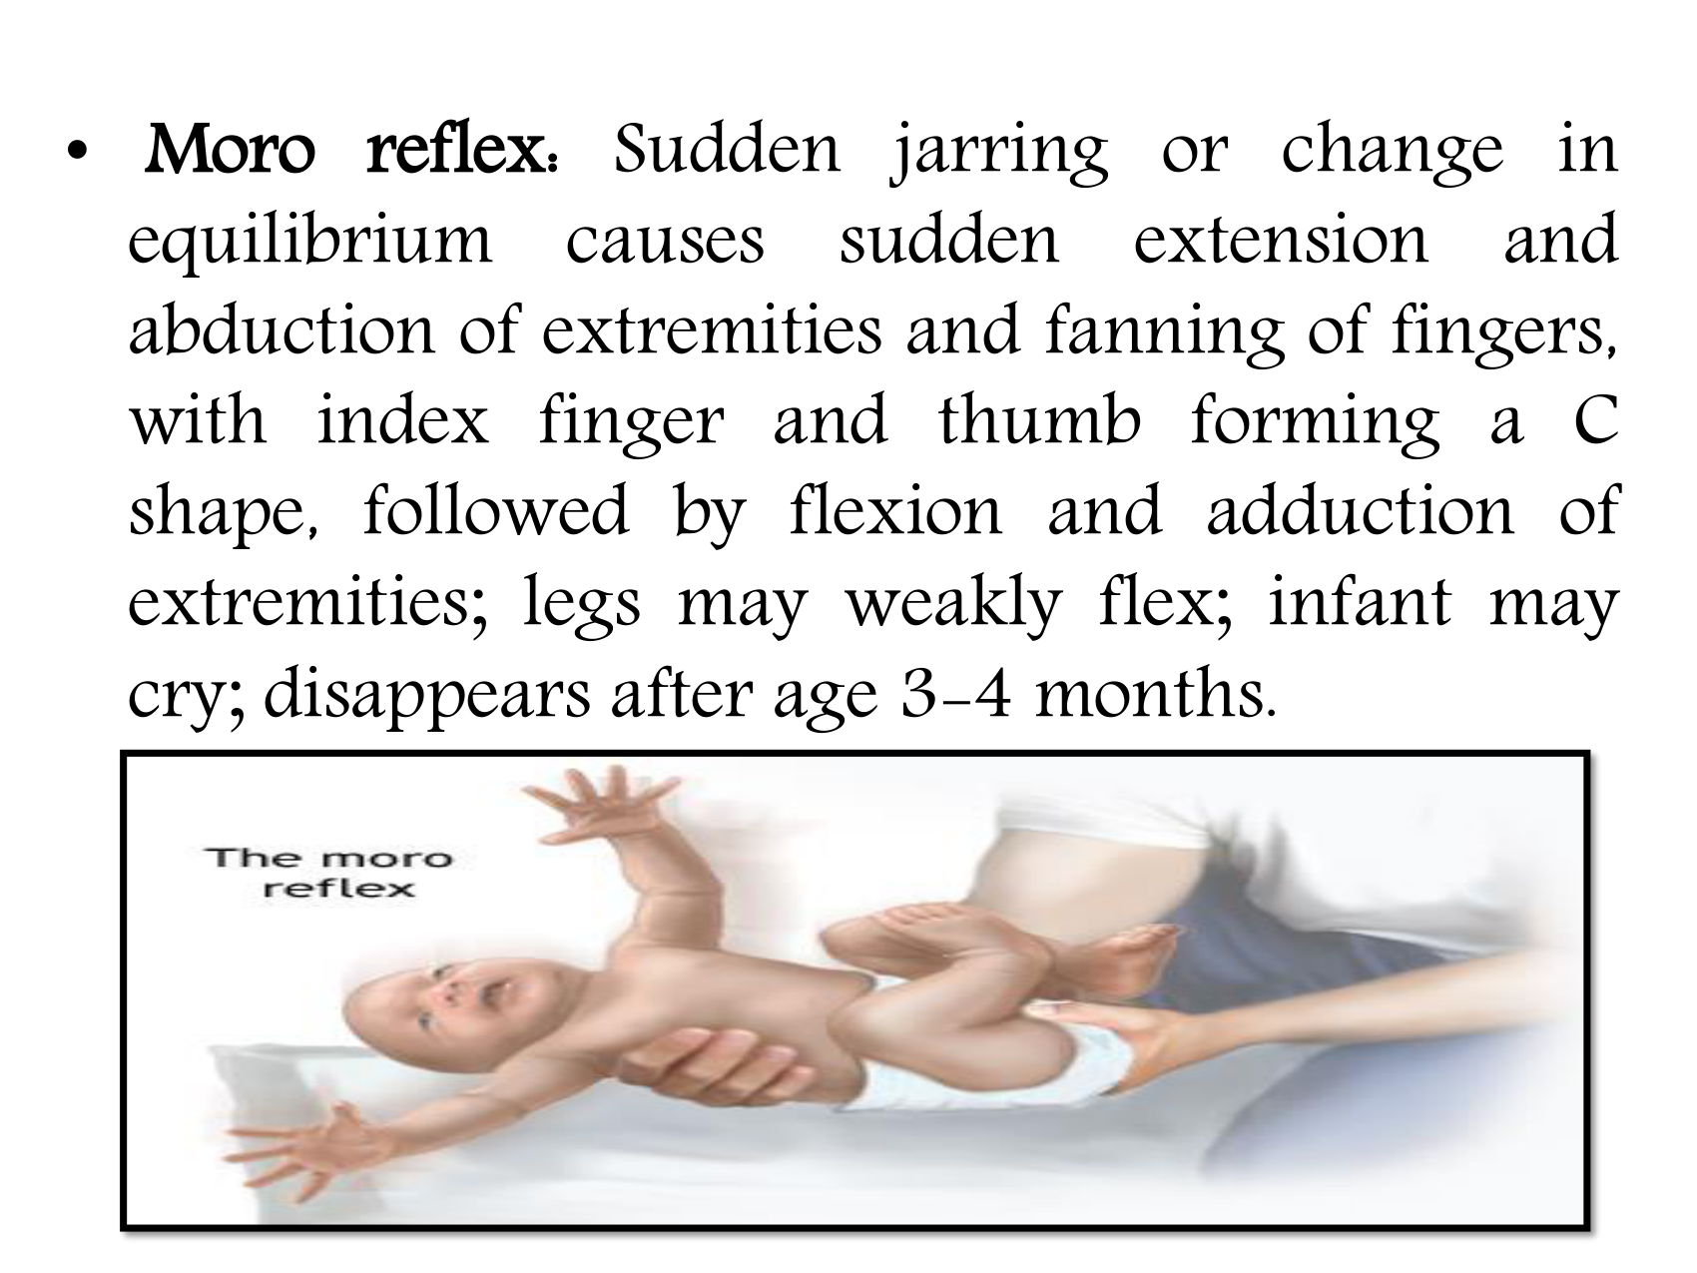
Newborn Reflexes (2024) · source page 9 of 14
Notes:
• Moro reflex: Sudden jarring or change in
equilibrium causes sudden extension and
abduction of extremities and fanning of fingers,
with index finger and thumb forming a C
shape, followed by flexion and adduction of
extremities; legs may weakly flex; infant may
cry; disappears after age 3-4 months.

Slide 12
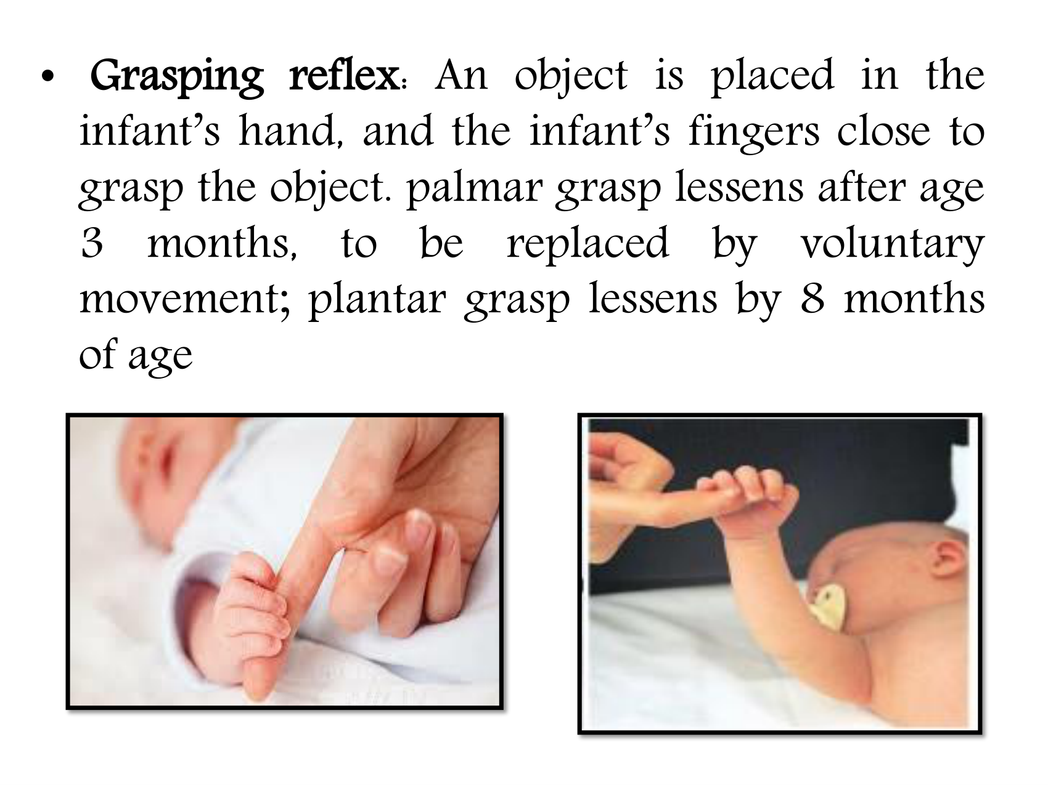
Newborn Reflexes (2024) · source page 10 of 14
Notes:
• Grasping reflex: An object is placed in the
infant’s hand, and the infant’s fingers close to
grasp the object. palmar grasp lessens after age
3 months, to be replaced by voluntary
movement; plantar grasp lessens by 8 months
of age

Slide 13
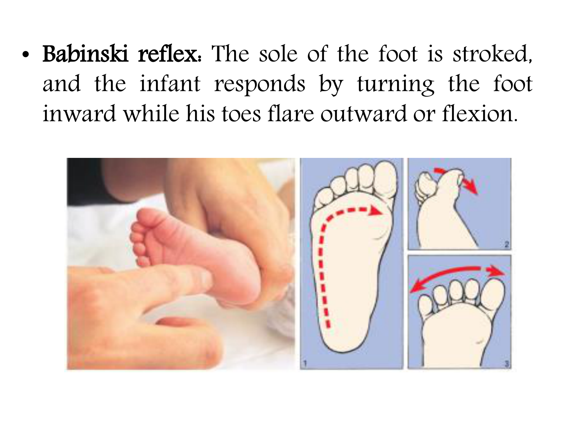
Newborn Reflexes (2024) · source page 11 of 14
Notes:
• Babinski reflex: The sole of the foot is stroked,
and the infant responds by turning the foot
inward while his toes flare outward or flexion.

Slide 14
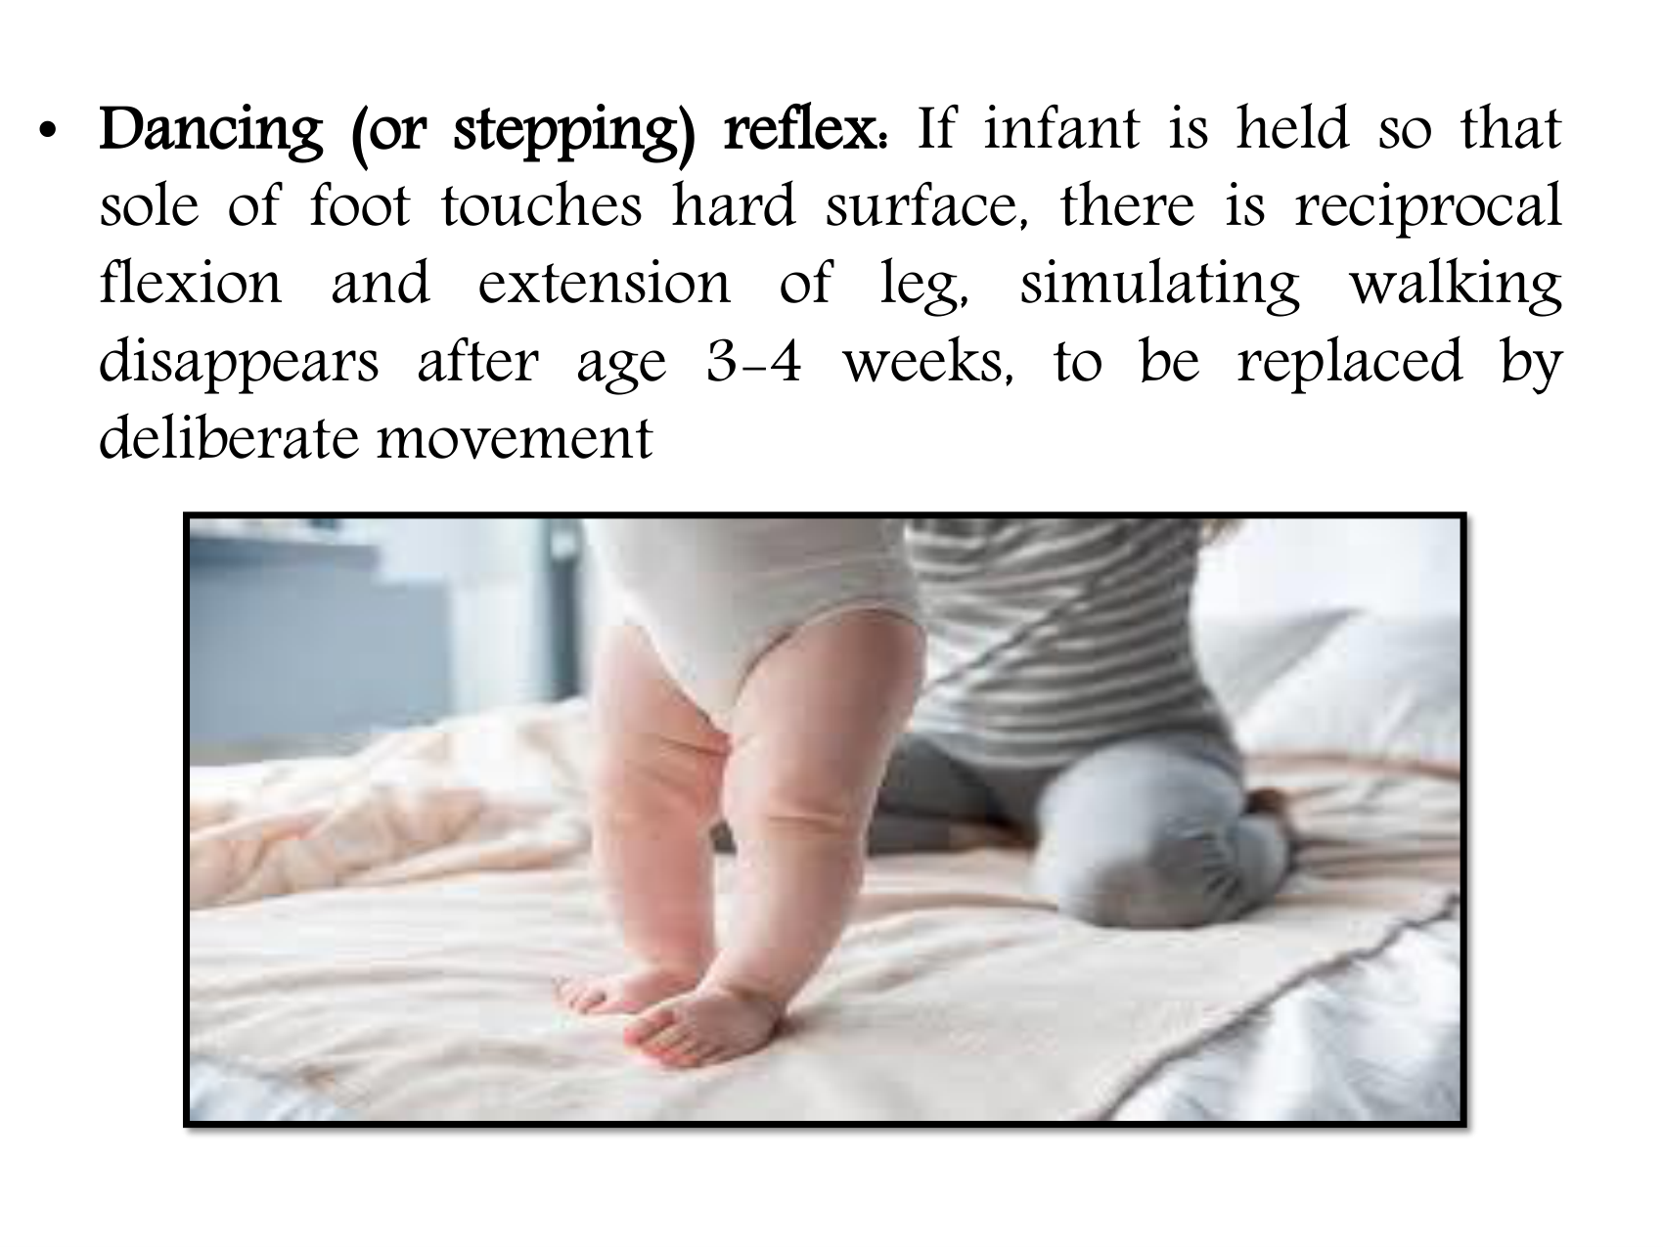
Newborn Reflexes (2024) · source page 12 of 14
Notes:
• Dancing (or stepping) reflex: If infant is held so that
sole of foot touches hard surface, there is reciprocal
flexion and extension of leg, simulating walking
disappears after age 3-4 weeks, to be replaced by
deliberate movement

Slide 15
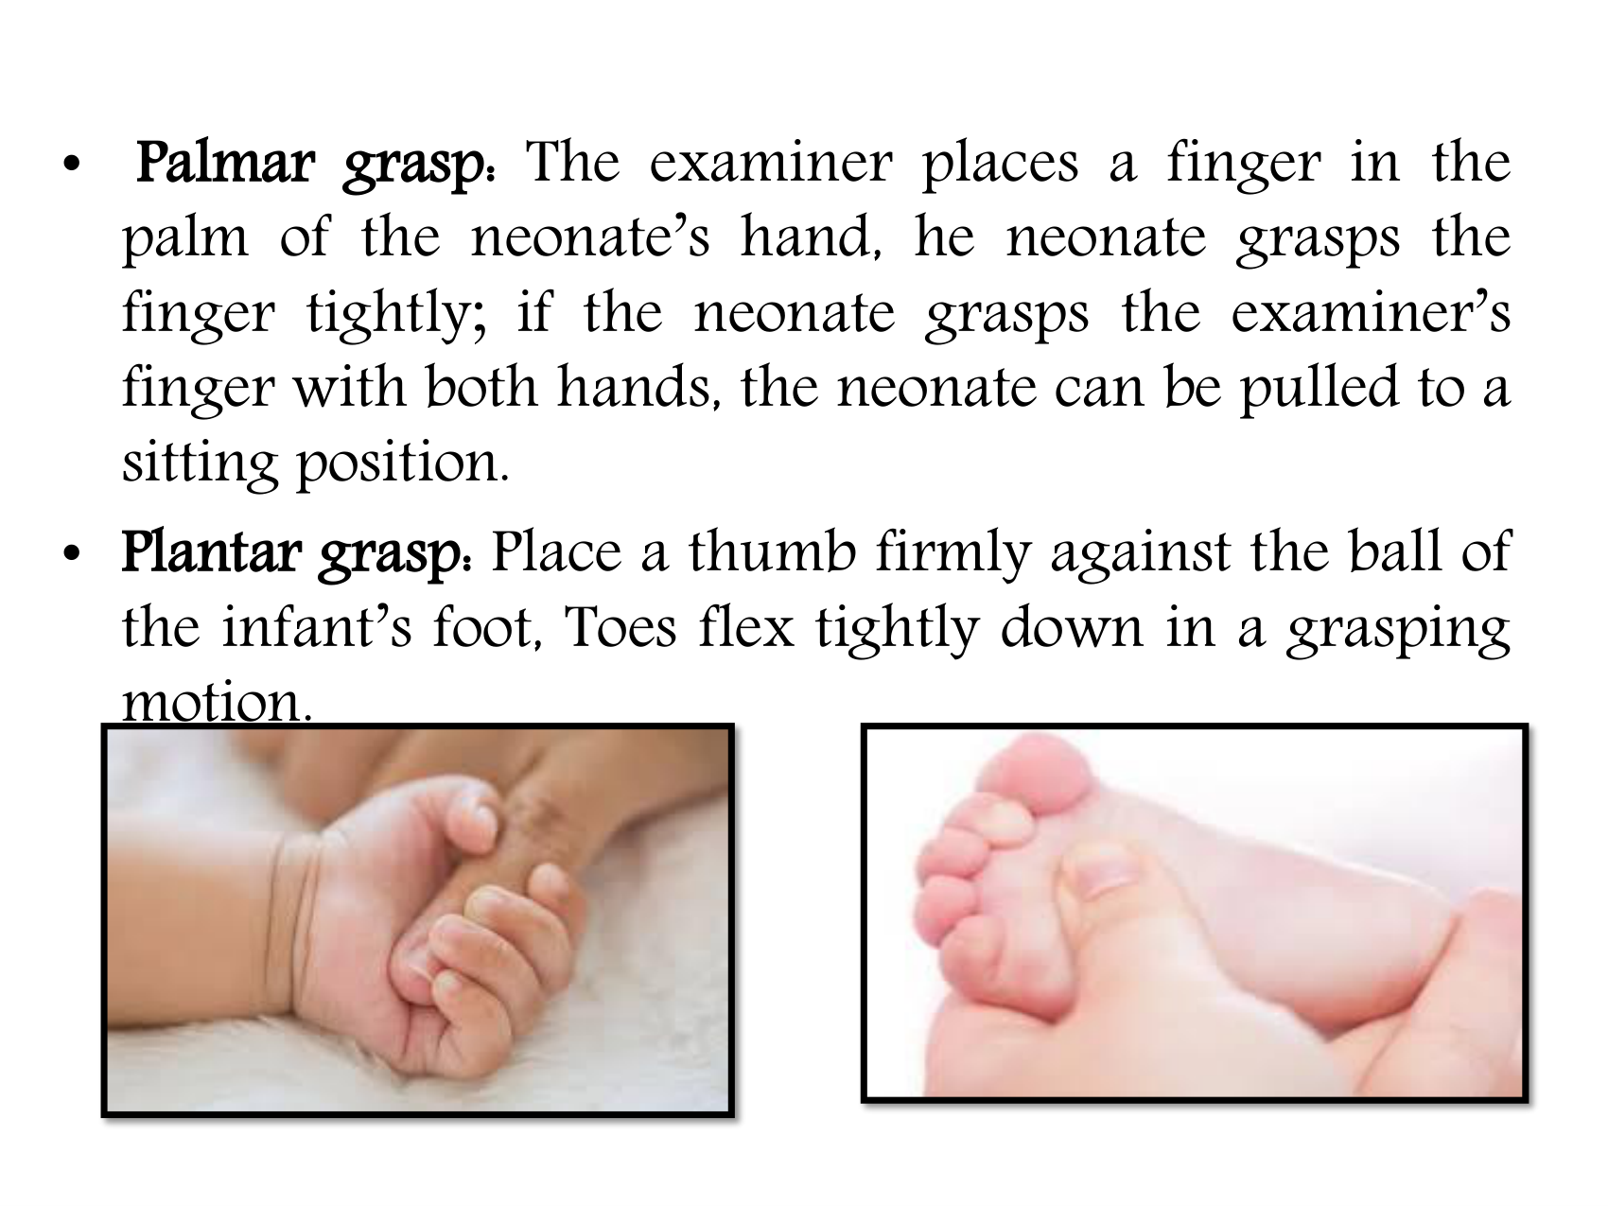
Newborn Reflexes (2024) · source page 13 of 14
Notes:
•
Palmar grasp: The examiner places a finger in the
palm of the neonate’s hand, he neonate grasps the
finger tightly; if the neonate grasps the examiner’s
finger with both hands, the neonate can be pulled to a
sitting position.
• Plantar grasp: Place a thumb firmly against the ball of
the infant’s foot, Toes flex tightly down in a grasping
motion.

Slide 16

Newborn Reflexes (2024) · source page 14 of 14

Slide 17
Document Information
Newborn Reflexes (2024)
انعكاسات حديثي الولادة (Reflexes 2024)
Source file: Reflexes 2024.pdf
Pages in source: 14
Slides in this deck: 17
Course: Pediatric Nursing — Practical Lectures
Full readable text and the original file are available on the lecture platform:
https://moustafaali-prog.github.io/pediatric-nursing-lectures/lectures/practical/Reflexes 2024.html
Notes:
Closing slide. Content reproduced verbatim from Reflexes 2024.pdf.

